Slide 1
Customer Segmentation Clustering
Presented by: Rasha Habib
Esraa Nassar
Shimaa Abdelkhalek

Slide 2
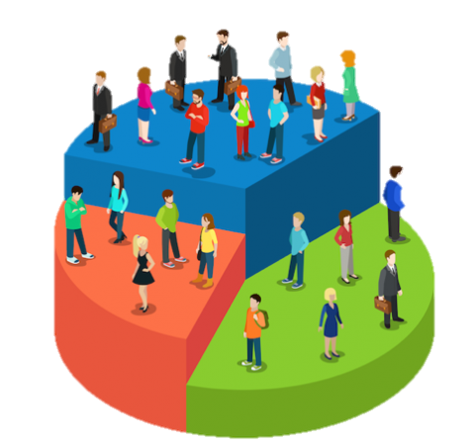
This project aims to know a company’s ideal customers on a deeper level.
By understanding who they are, what they like, and how they behave, businesses can tailor their products to fit the unique needs of different customer segments.

Slide 3
Data Exploration

Slide 4
First things first, we used dataset from: https://www.kaggle.com/code/annastasy/consumer-behavior-cluster-analysis-kmeans/notebook
This data set contains features more than other datasets which allow us to perform data analysis, and we were able to try different models
Data shape: (2240, 29)

Slide 5
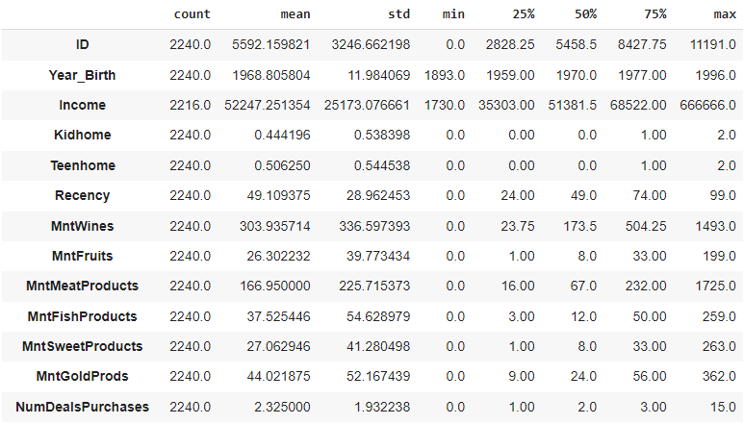
Data Description

Slide 6
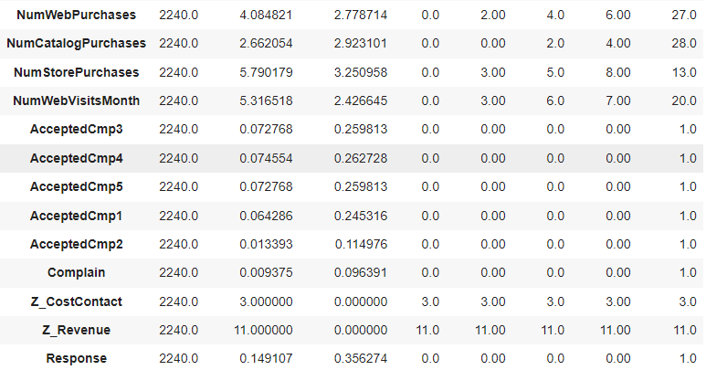
Data Description

Slide 7
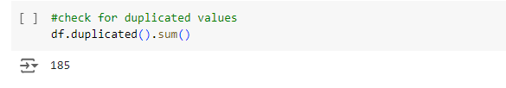
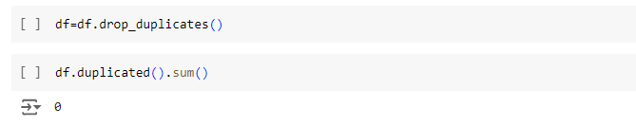
Keeping data clean by:
1- Remove duplicates

Slide 8
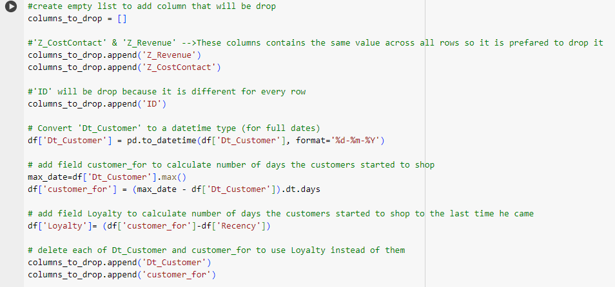
2- Removing unnecessary columns

Slide 9
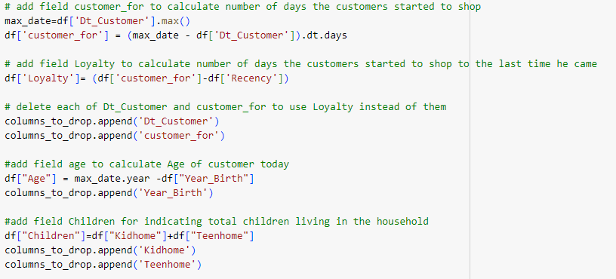
3- Feature Engineering

Slide 10
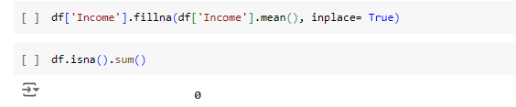
3- Checking for null values
Replacing null in income using mean imputation

Slide 11
Data Analysis and visualization

Slide 12
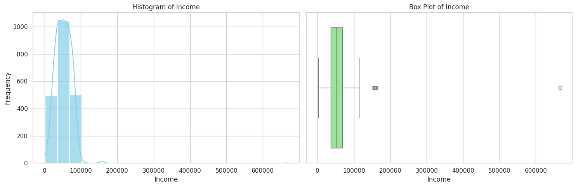
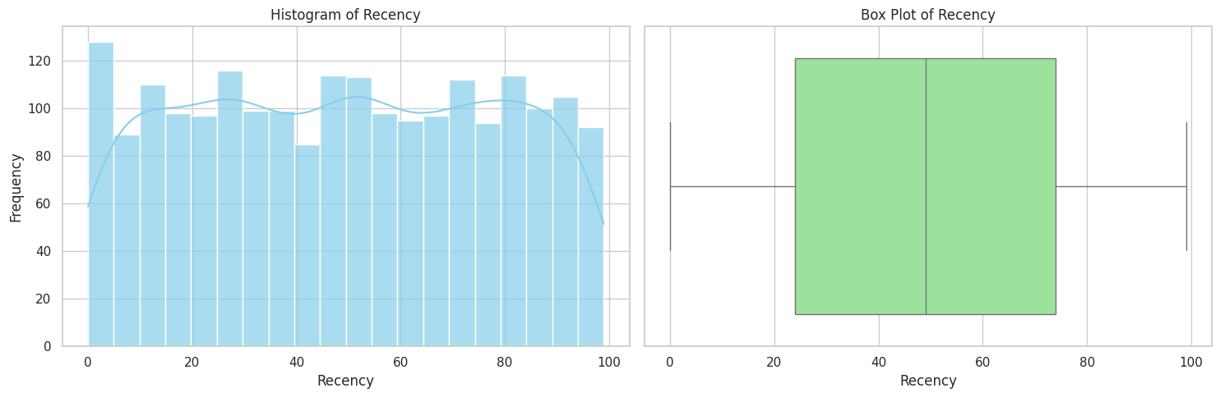
Univariate Analysis

Slide 13
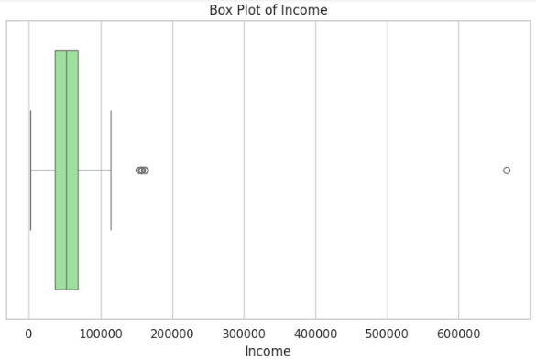
Dropping outliers
For features Income, loyalty, Age, spend

Slide 14
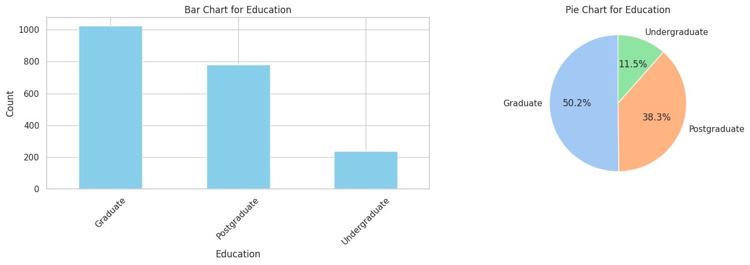
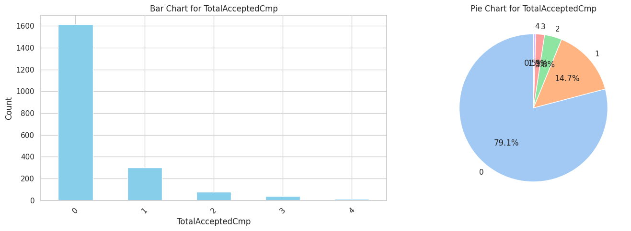
Univariate Analysis for categorical data

Slide 15
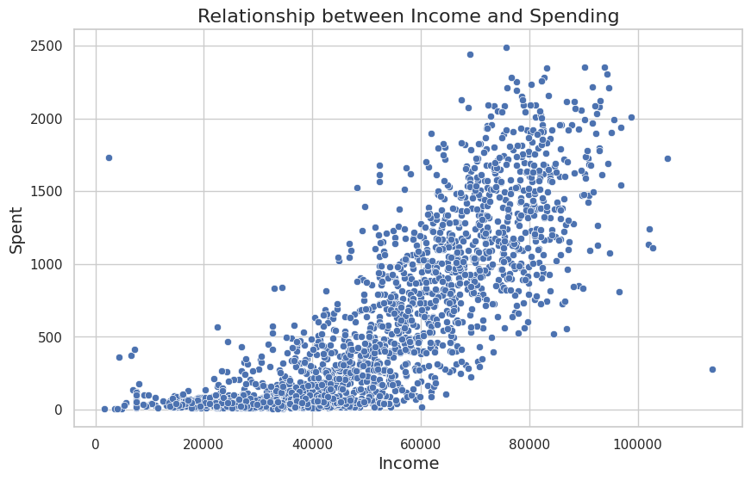
Bivariate Analysis
The following scatter diagram shows relation between income and spend of customers

Slide 16
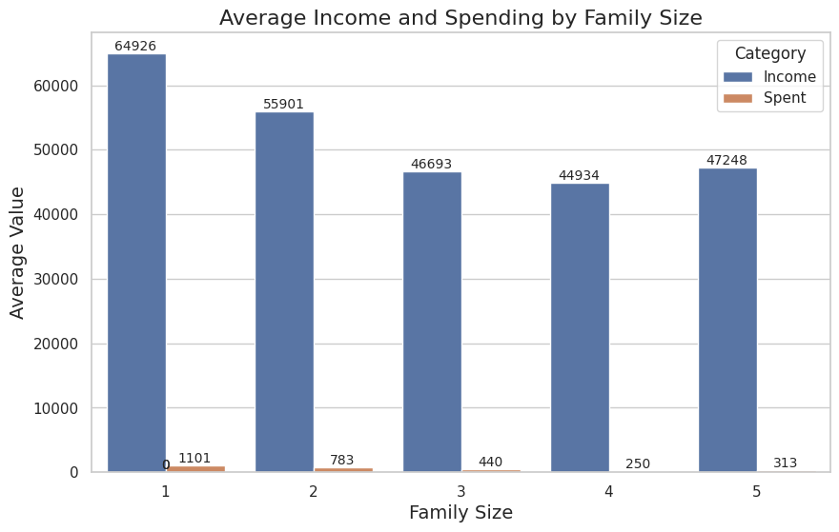

Slide 17
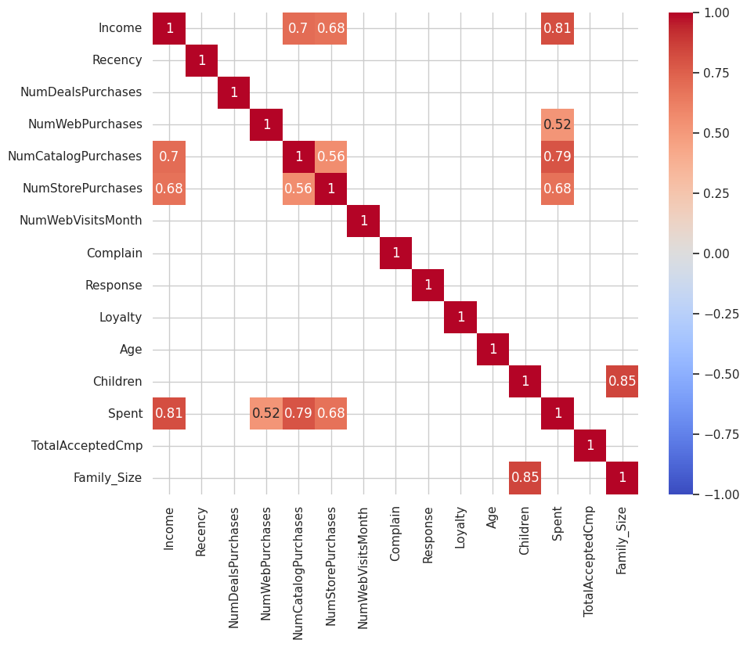
Correlation matrix
Showing correlations greater than 0.5

Slide 18
Machine learning Model

Slide 19
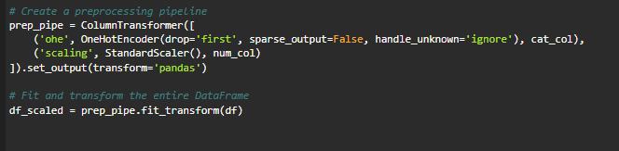
Preprocessing:
Creating pipeline for preprocessing
1- using one hot encoder for categorical features
2- using standard scaler for numerical features

Slide 20
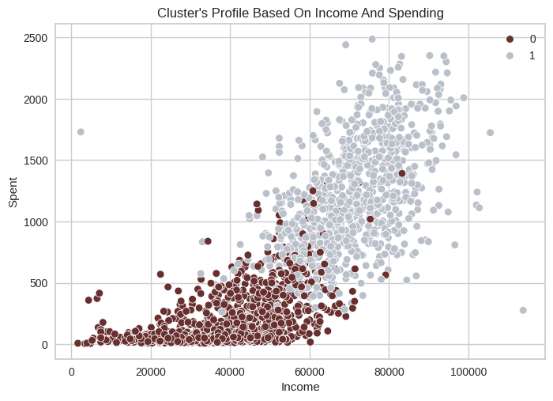
First: Using K-means Cluster
Making assumption k = 2

Slide 21
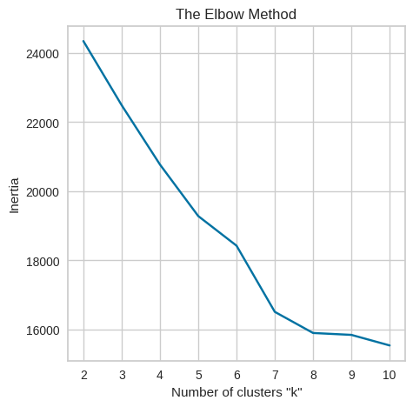
To determine the number of clusters we used two methods:
1- Elbow Method:
Apply Elbow Method to determine the optimal number of clusters

Slide 22
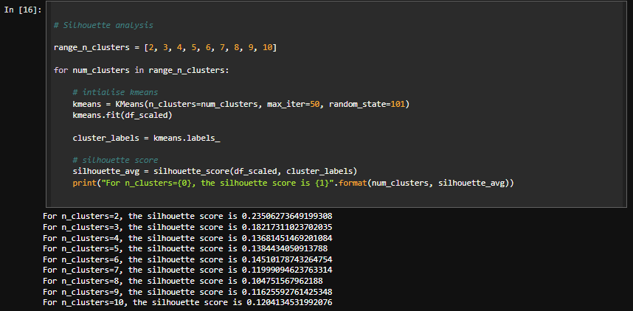
2- Silhoutte Method

Slide 23
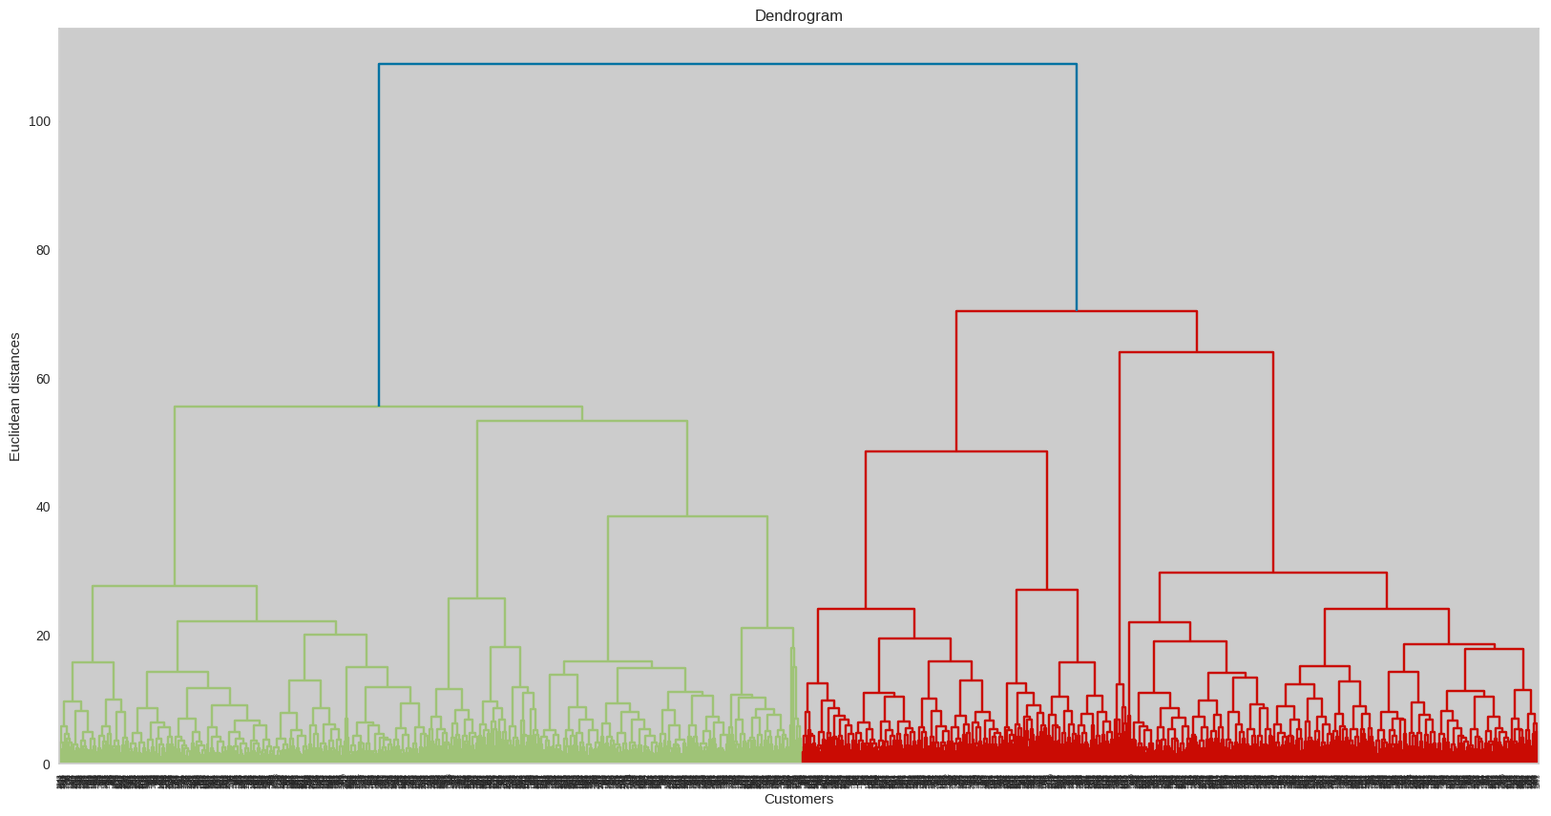
Second: Using Hierarchical Cluster

Slide 24
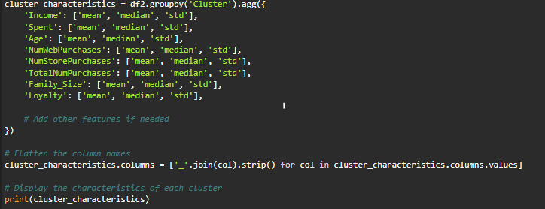
Define Cluster characteristics to be able to profile customers

Slide 25
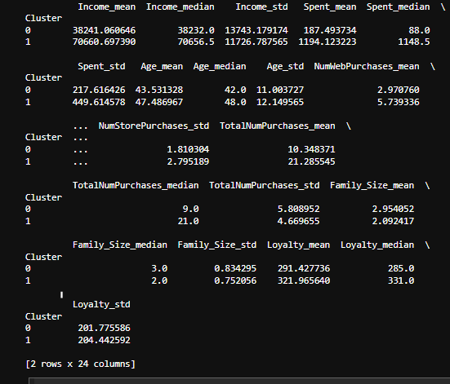

Slide 26
Conclusion

Slide 27
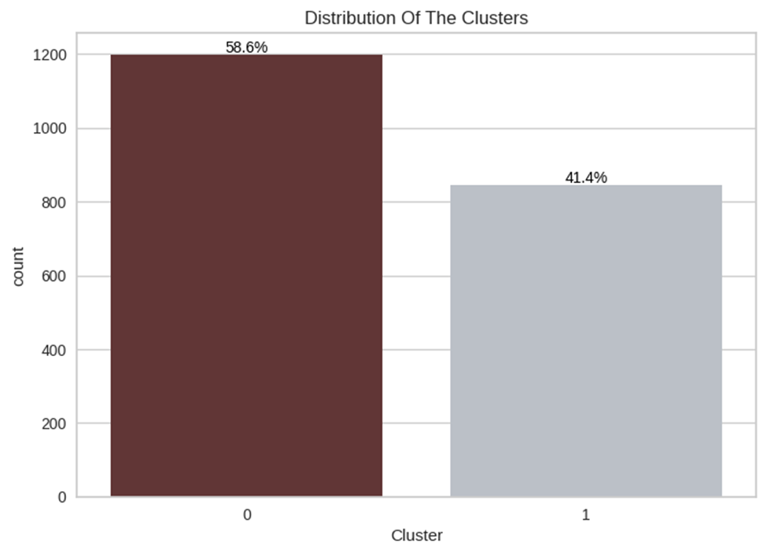
The best number of clusters is 2
customer segments can be classified as: cluster 0 with 58.6%
Cluster 1 with 41.4 %

Slide 28
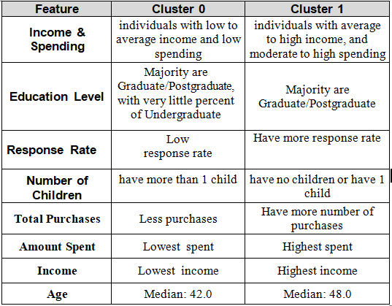

Slide 29
Thank you

